Slide 1
Decision Support to Improve Childhood Obesity Management
Jeremy Michel, MD, MHS
Physician-Informatician
The Children’s Hospital of Philadelphia & ECRI Institute

Slide 2
Disclosures
Work I will be discussing was indirectly funded by the American Beverage Foundation through an unrestricted grant to the Healthy Weight Program at The Children’s Hospital of Philadelphia.

Slide 3
Childhood Obesity
The greatest predictor of adult obesity is childhood obesity
Childhood obesity uses Body Mass Index percentiles (BMI %tile)¹
14.9% of all children are considered overweight (BMI ≥ 85th and < 95th %tile)
16.9% of all children are considered obese (BMI ≥ 95th %tile)
We conducted a needs assessment at CHOP to gage the interest level in an obesity management intervention and to identify user requirements
¹ Ogden CL, Carroll MD, Kit BK, Flegal KM. Prevalence of Childhood and Adult Obesity in the United States, 2011-2012. JAMA. 2014;311(8):806-814. doi:10.1001/jama.2014.732.
² Robbins JM, Mallya G, Polansky M, Schwarz DF. Prevalence, Disparities, and Trends in Obesity and Severe Obesity Among Students in the Philadelphia, Pennsylvania, School District, 2006–2010. Prev Chronic Dis 2012;9:120118

Slide 4
Childhood Obesity at CHOP: Needs Assessment Findings
Strong clinician interest in “something” to help with obesity management in primary care
Recognition of weight status and screening laboratory evaluations¹ are over-reported
Unexplained clinical care and workflow variability exist
Some clinicians manage obesity, some refer to specialists, and some co-manage
Most clinicians use the BMI %tile and some use the BMI (numeric) value
Some clinicians use patient handouts but some didn’t know these materials existed
Many clinicians reported using other resources (links, websites, and handouts)
¹ AST + ALT + Lipid panel + Glucose for obese patients OR Lipid panel for overweight patients
Notes:
90% report always or frequently documenting weight status but actual documentation rates are 21% (overweight) and 64% (obese)
85% report ordering screening laboratory evaluation but only 50% of patients had screening laboratory evaluation ordered

Slide 5
Next Step: Plan the Intervention
We had evidence from our preliminary work that an intervention was both wanted and needed
The intervention would need to account for multiple workflows
Many strong divergent opinions collected during the needs assessment lead to our interest in an evidence-based intervention
Now onto building decision support and putting it into practice

Slide 6
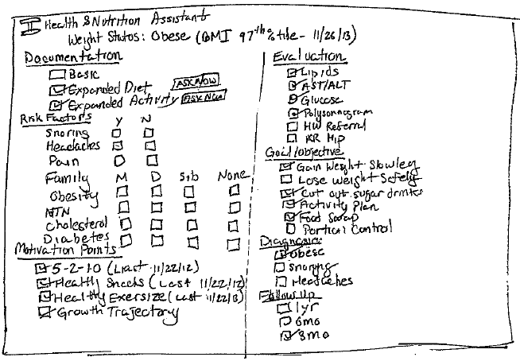
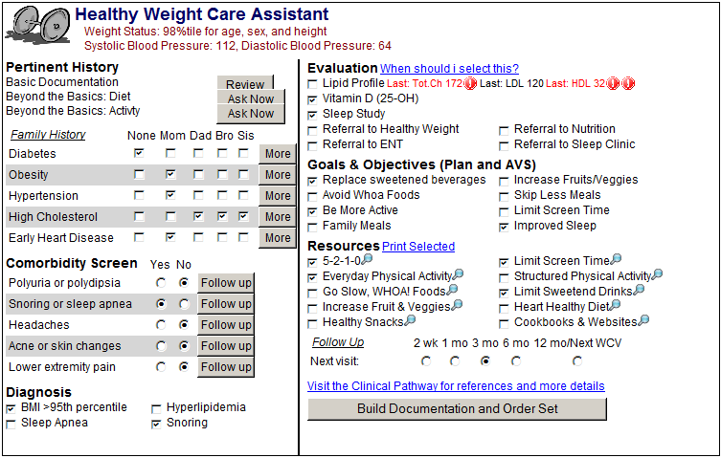
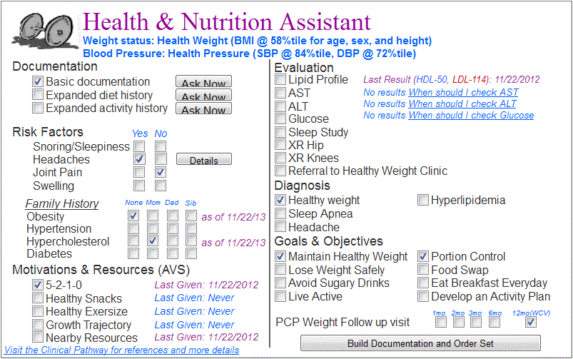
How We Designed Healthy Weight
Stage 1:
Freehand mockup
Stage 2
Wireframe mockup
Stage 3
Interactive module
Stage 4
User testing, feedback
Stage 5
Redesign, Enhance, Evaluate
Notes:
Stage 1
Quick, easy, low overhead, adaptable
Stage 2
Layout, spacing, internal workflow (white box testing)
Stage 3
Interactivity, data handling, processing speed (integration testing)

Slide 7
Before and After Implementation
Testing before implementation
Everything functions as expected
Patient data is appropriately handled
The CDS does not break the EHR
Testing after implementation
How do different clinical workflows impact use
Is there an impact on efficiency
Is there an impact on patient care

Slide 8
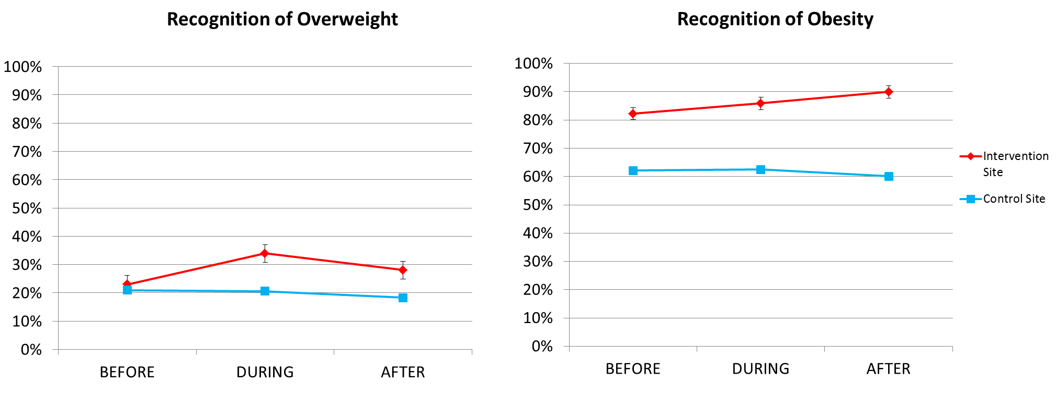
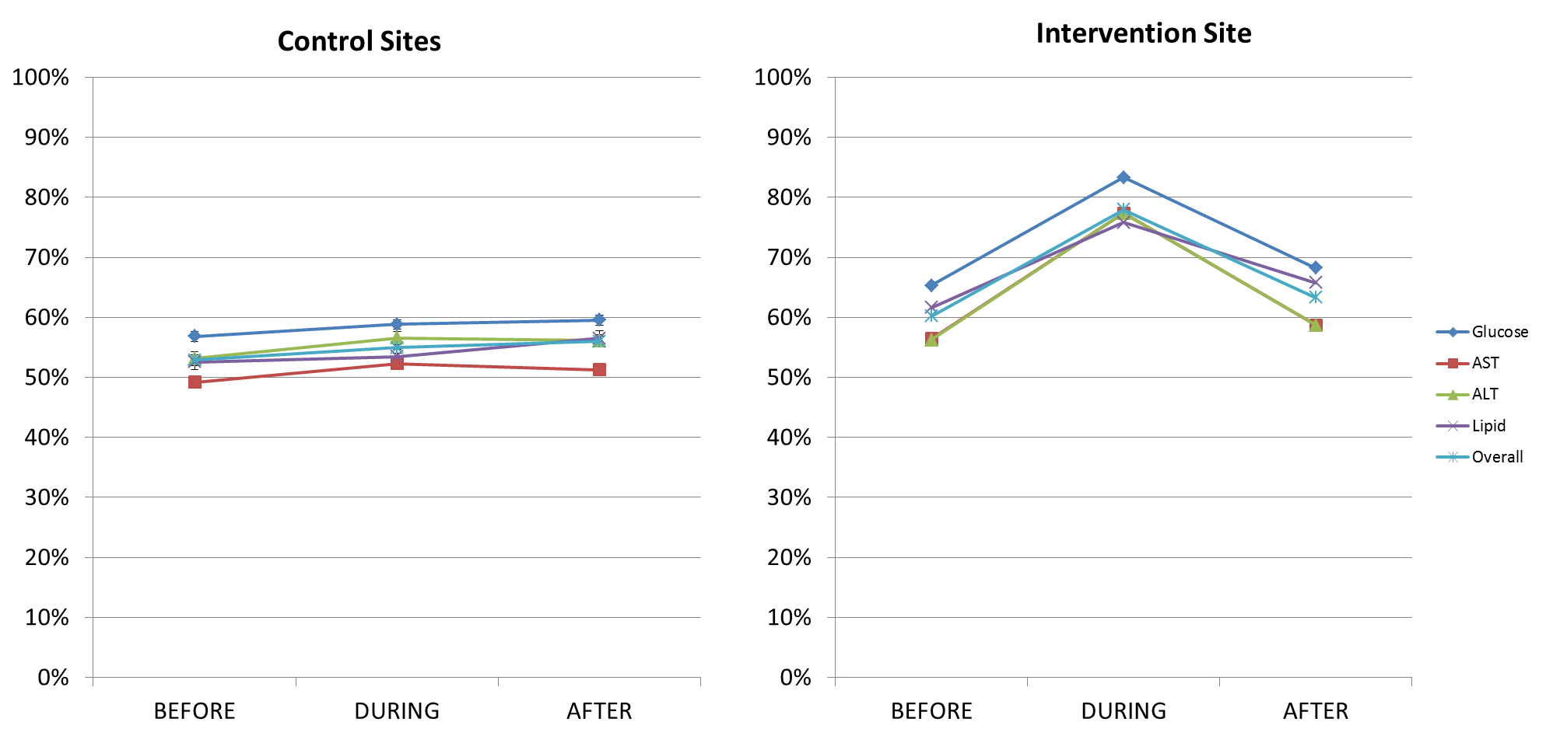
Clinical Use: Patient care impact
Recognition:
Evaluation:
Notes:
7%-point increase in recognition of obesity
18%-point increase in comorbidity screening lab evaluation

Slide 9
Clinical Use: Unanticipated issues
Large patient data effect
Patient data strained and slowed the system
Patient data is often incomplete and contained partial values
Multiple unanticipated workflows
Users were only using the internal documentation area
Users were selecting labs and not opening order set
Users were selecting labs and opening in order only encounters
Unmasking of system issues
“Medication & Order Handler Error” firing with increasing frequency
System Changes affecting our application
Change from “accucheck” to “hemacue-glucose”
Notes:
Internals: this did not save automatically because of when the save function was triggered

Slide 10
Redesign, Enhance, Evaluate
Redesign: Address the issues impacting users
Used templates and pre-processing to improve efficiency
Made adjustments to account for unanticipated workflows
Communicate with users regarding use of order set
Enhance: Promote links to the Evidence-Base
Link to the Clinical Pathway for Childhood Obesity
Developed a “Learning Link”
Improve clinician knowledge of obesity management
Improve clinician comfort using the Healthy Weight Care Assistant
Evaluate: Monitor usage and data
Noted decreased glucose ordering; this was directly related to a poorly communicated change to the ‘accucheck’ order

Slide 11
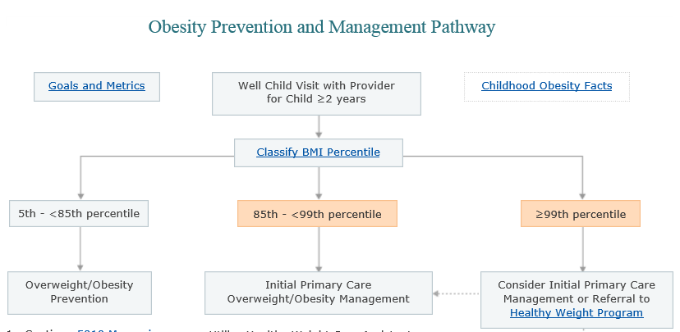
Concurrent Development of Clinical Pathway for Childhood Obesity
The “Obesity Prevention and Management Pathway”
Continued coordination between CDS and pathway developers
Agreed to shared evidence base
Interlinked
Coauthored “Learning Link”
The pathway informs clinicians what they should consider doing and the CDS helps them do it

Slide 12
Concurrent Development of Quality Indicators / Clinical Metrics
Using the shared code lists and datasets, we worked with our quality reporting department to design performance feedback metrics surrounding obesity management practices.
Targets were recognition of obesity and appropriate screening laboratory evaluation derived from the evidence-based recommendations from the selected Expert Committee ‘guideline’
The CDS helps clinicians provide evidence-based care; the metrics provide feedback on the care provided

Slide 13
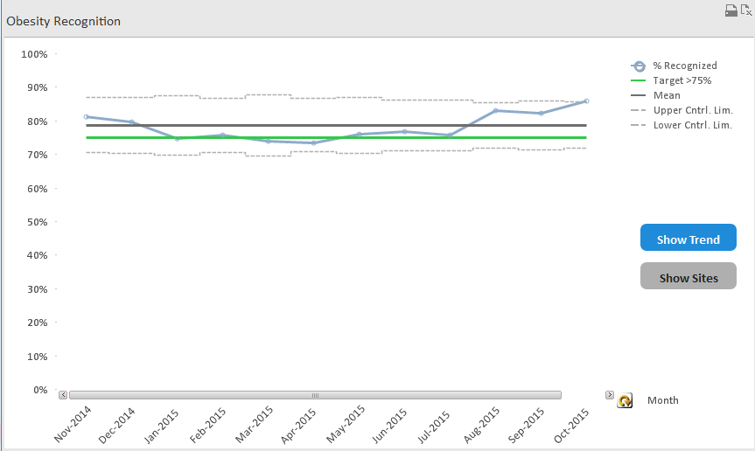
Concurrent Development of Quality Indicators / Clinical Metrics
Pathway Published
CDS Activated
at this care site

Slide 14
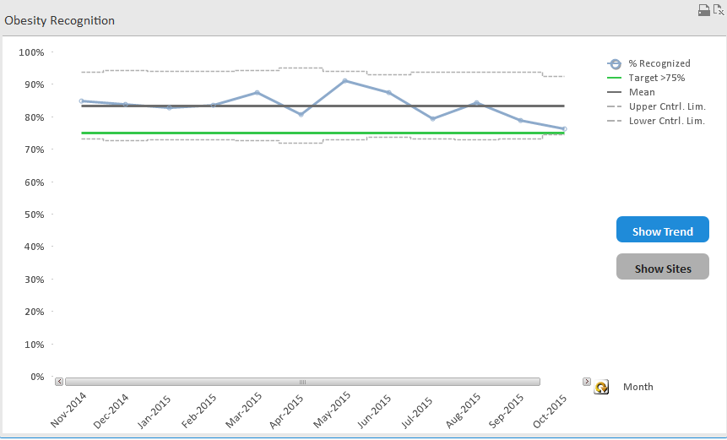
Concurrent Developments Beyond our Control
Pathway
Published
CDS Activated
at this care site
Clinical Champion
left this care site

Slide 15
Conclusions
Developing CDS from an evidence-based guideline is possible
Even minimally tested CDS can have an immediate impact on patient care, but inadequate testing is a risk for unanticipated consequences
It can be integrated with a quality improvement project and clinician feedback system
Be responsive to system changes that affect your projects, if something isn’t working as anticipated – investigate why

Slide 16
Thank you!
Healthy Weight Care Assistant Project Team
Saba Khan, MD
Mariko Mui, MD
Patricia DeRusso, MD
Allison Herman
Ethan Jacobi
Sarah Hadley

