Slide 1
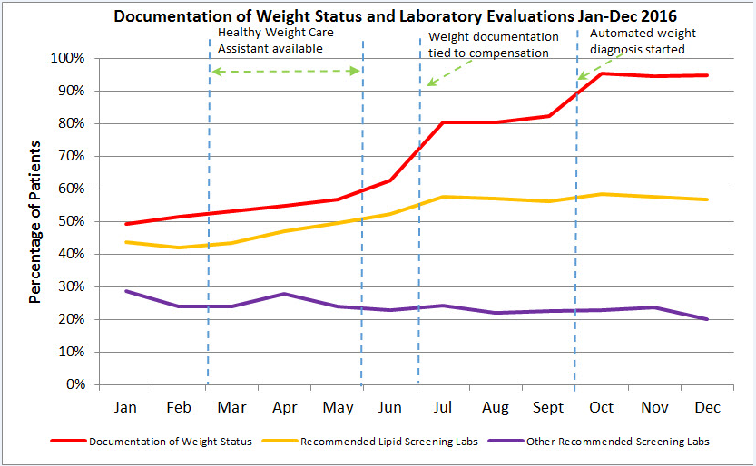
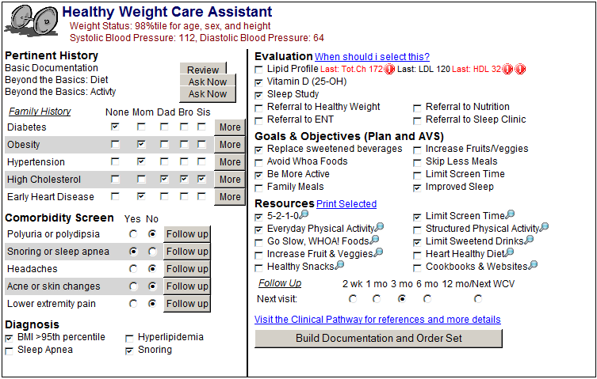
Impact of Multiple Clinician Focused Interventions on Childhood Obesity Documentation and Management
For more information, please contact:
Email: michelj@email.chop.edu
Jeremy Michel, MD, MHS^{1,2}, Jeffrey Miller, MAS¹, Emily Gregory, MD^{1,2}
¹The Children's Hospital of Philadelphia, Philadelphia, PA, United States. ² The Department of Pediatrics, Perelman School of Medicine University of Pennsylvania
Background
Results
Almost 30% of US children are overweight/ obese.
There is unexplained variation in care of these patients.
Management guidelines include documentation of weight status and laboratory screening for co-morbidities.
In our primary care network, adherence to guidelines was low and uneven across individual clinicians and practices.
Across Network (Figure 1):
Documentation of weight status improved from 49% to 94%.
Appropriate lipid screening orders increased from 43% to 56% among overweight and obese patients.
Orders for AST/ALT/glucose among the obese population decreased from 28% to 20%.
Subgroup Analysis:
Practices receiving clinical decision support* (Figure 2) had improved AST/ALT/glucose screenings while the CDS was active (with CDS 31.5%; without CDS 28%).
Sites without incentives did not improve documentation rates until automation occurred. These sites had lipid screening rates that were largely unaffected by automation (pre-automation 40%; post-automation 38.5%).
* CDS provided laboratory ordering and diagnosis support
Objective
Evaluate the impact of multiple interventions on appropriate obesity documentation and on adherence to management recommendations.
Figure 1. Recognition of weight status and clinician adherence to screening recommendations for children with BMI > 85% tile (Jan-Dec 2016)
Figure 2. Healthy Weight Care Assistant
Methods
Interventions across the institution during study period:
Feb – May 2016: Clinical decision support (CDS) piloted at six sites. (“Healthy Weight Care Assistant”)
July 2016: Weight status documentation* tied to financial incentives for clinicians at 25/28 ambulatory sites.
October 2016: Weight status documentation automated within the well child order set at all sites.
A EHR-linked application was developed to track QI goals:
Quality improvement (QI) goals: Determined by a Pediatric Obesity Advisory Board based on expert recommendations (Barlow et.al., 2007)
GOALS:
1) Improve documentation* of overweight/obesity to 80%
2) Appropriate comorbidity screening** improved to 50%
Discussion
*Weight Status Recognition Documentation:
Diagnosis OR problem list entry of overweight for patients with a BMI 85th - 95th percentile
Diagnosis OR problem list entry of obese for patients with a BMI above the 95th percentile
**Appropriate comorbidities screening:
Obese and Over 10 years: AST, ALT, Glucose, AND Lipids ordered within the past 2 years
Overweight and Over 10 years OR Obese: Lipids ordered within the past 2 years
Financial incentives and automation of weight status documentation immediately preceded increased rates of weight status documentation.
Improved documentation of weight status was not associated with achieving QI goals around comorbidity screening.
Electronic CDS did improve appropriate comorbidity screening, but there was an immediate return to baseline screening rates after discontinuation of the CDS intervention.

