Slide 1
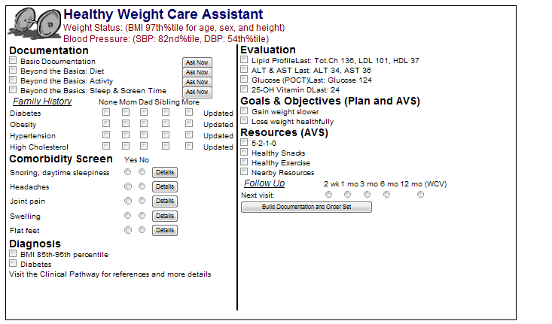
Center for Biomedical Informatics
Preparing for a Childhood Obesity Clinical Decision Support Intervention
Using EHR Data and Clinician Feedback to Determine the Intervention Targets
For more information, please contact:
Email: michelj@email.chop.edu
Jeremy Michel, MD, MHS, Pediatrics and Clinical Informatics, Mari Mui, MD, Pediatrics, Allison Herman, MEd, MPH, Clinical Research Coordinator, Patricia DeRusso, MD, MS Director, Healthy Weight Program
Background
Results
Discussion
Childhood obesity is a national health crisis
Clinicians do not consistently recognize obesity or overweight status
Clinicians do not consistently document obesity or overweight status
Lack of recognition or documentation can prevent initiation of therapy
Clinical Decision Support (CDS) can be used to improve recognition
CDS may be beneficial for other aspects of management, however:
Baseline data on obesity recommendation adherence is unknown
Comprehensive CDS interventions in pediatrics are not well studied
It was unclear what type of CDS would be beneficial in our institution
Baseline overweight/obesity prevalence
There is a discrepancy between reported and calculated adherence to diagnosis and management recommendations
Although 99% of clinicians reported it is their role to diagnose obesity, fewer than half of obese patients had a diagnosis
Clinicians reported several different workflows, including where they access BMI data and their role in management
There was a strong interest in a CDS intervention
Overweight patients:
34,971 (16.76%)
Obese patients:
28,451 (13.64%)
Clinician documentation of overweight/obesity status
Most clinicians (92%) reported “always” or “frequently” documenting weight status Most clinicians (88%) reported adding the diagnosis to the problem list
The Future
Actual EHR documentation rates:
Overweight – 13.30% Obese – 49.48%
Based on the EHR data and survey responses, we have identified several targets for the future CDS intervention
streamlining evaluation and management
increasing documentation of weight status
facilitating ordering laboratory testing
improving access to educational materials
Objectives
Characterize adherence to obesity diagnosis and management recommendations using self-reported data and EHR data
Obtain wide-based user input into the development of a CDS module for obesity management
1
3
Methods
2
Determined baseline overweight/obesity prevalence within CHOP Care Network
Developed metrics for two recommendations from the ‘Expert Committee Recommendations Regarding the Prevention, Assessment, and Treatment of Child and Adolescent Overweight and Obesity:’
Appropriate documentation of weight status using ICD-9 codes
Diagnosis of overweight at a visit or as a problem list entry for patients with a BMI between 85th and 95th percentile
Diagnosis of obese at a visit or as a problem list entry for patients with a BMI above the 95th percentile
Appropriate laboratory evaluation for comorbidities in children ages 10+
AST/ALT/Glucose/Lipid ordered within the past 2 years or at the index visit
Used SQL to collect data on 208,643 patients seen Jan 1st 2012 to Dec 31st 2012
Administered survey to 311 Primary Care Physicians in the CHOP Care Network
Surveys administered through RedCAP to support anonymous data collection
Survey questions covered:
various clinician roles in obesity management
workflow and documentation practices
opinions for proposed intervention targets
Appropriate laboratory evaluation in obese children ages 10+
85% of providers reported starting screening labs before 10 years
Actual EHR documentation rates:
Disorder (laboratory studies) | % of patients with test orders at a visit or within last 2 years
Fatty Liver Disease (AST) | 15.8%
Fatty Liver Disease (ALT) | 24.9%
Hyperlipidemia – overweight (Lipid) | 26.0%
Hyperlipidemia – obese (Lipid) | 53.2%
Diabetes (Glucose) | 36.4%
4
Clinician Survey Response Data
We had 112 survey responses (35% response-rate)
99% reported it was their role to diagnose obesity
55% reported their role included management of obese children with comorbidities
64.5% used the EHR embedded educational material
75% used non-EHR resources (websites, paper handouts, other materials)
Summary
Using our EHR data and clinician feedback we have identified targets for our future CDS intervention. We anticipate that encouraging provider involvement at this early stage will improve clinician acceptance of the in development Clinical Decision Support.
Opinions of proposed intervention targets:
35.8% had interest in streamlined evaluation and management
30% had interest in improved educational materials
9.4% had interest in better documentation templates
2.8% did not wish for any intervention

